Slide 1
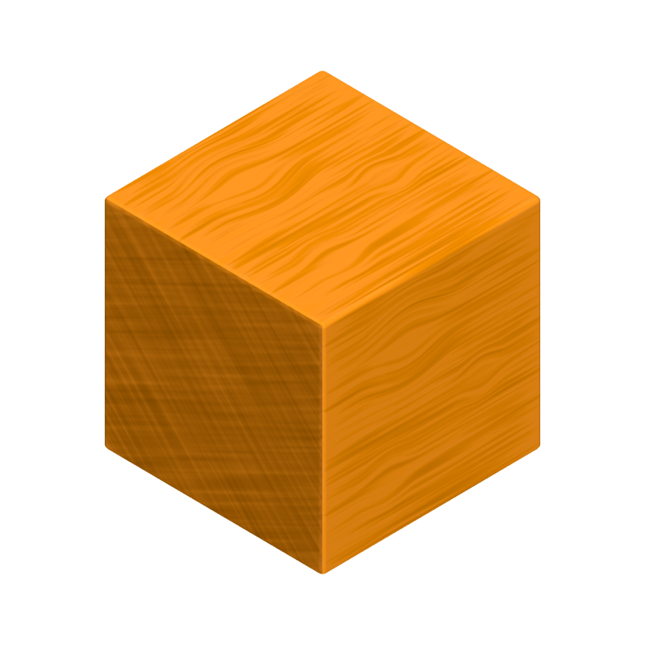
Coding with the Cubeling app
Tasks to use in lessons
Stefan Janke, Heiko Etzold

Slide 2
Name tag
Toss a die and do all actions that are assigned to a number less than or equal to the one you rolled:
Make yourself a name tag!
Write an adjective in fron of your name that begins with the same letter as your first name!dein Vorname!
Draw a small picture on your name tag that has something to do with your favorite hobby!
Estimate how many cubes each of your classmates would have to take out of the box so that all children have the same number of cubes. Write this number on your name tag!
Think about what animal living in the forest you would most like to be and draw or write it on your name tag!
Try to recreate this animal using the cubes.
Stefan Janke

Slide 3
The cube
Imagine an alien standing in front of your door tomorrow morning. It has learned your language quickly due to its high intelligence, but it has never come across a shape that is not round. For your new board game, however, you need a cube? Try to explain to the creature what a cube is.
Stefan Janke, Nevit Dilmen (https://commons.wikimedia.org/wiki/File:Alien1ces.svg)

Slide 4
The cube
Act out the situation with the person sitting next to you by pretending to be the alien!
The alien here is completely unknowledgeable and should ask critical questions if it does not understand something.
Afterwards, switch roles.
Stefan Janke, Nevit Dilmen (https://commons.wikimedia.org/wiki/File:Alien1ces.svg)

Slide 5
Connected cube structures
Put a privacy shield between you and the person sitting next to you.
Think of a cube structure with 10 cubes and build it on your side.
Next, explain to your partner how they can build this structure.
Then, compare your cube structures and switch roles.
Stefan Janke

Slide 6
Connected cube structures
What problems arose when describing the building process of the cube structure?
Stefan Janke

Slide 7
Cubeling app
Imagine you are architects and want to describe a cube structure to a computer so that it can model it. Unambiguity and clarity are of particular importance here.
Find out everything the Cubeling app can do.
Stefan Janke, Heiko Etzold

Slide 8
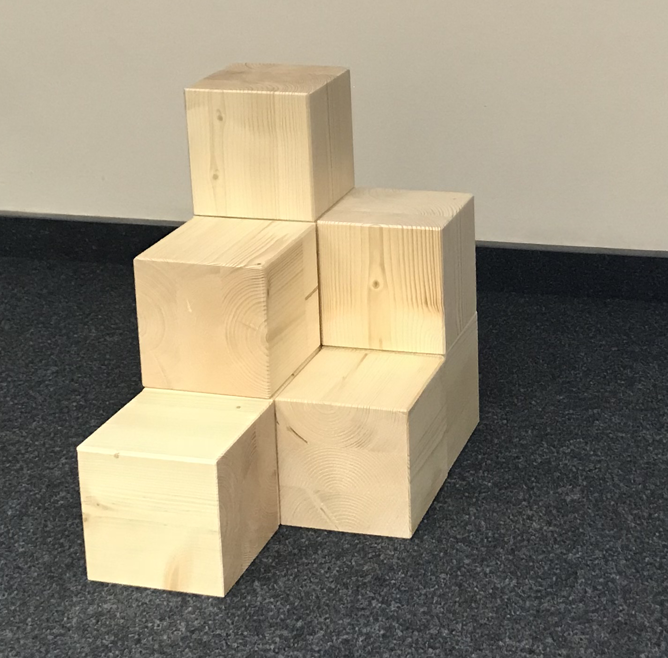
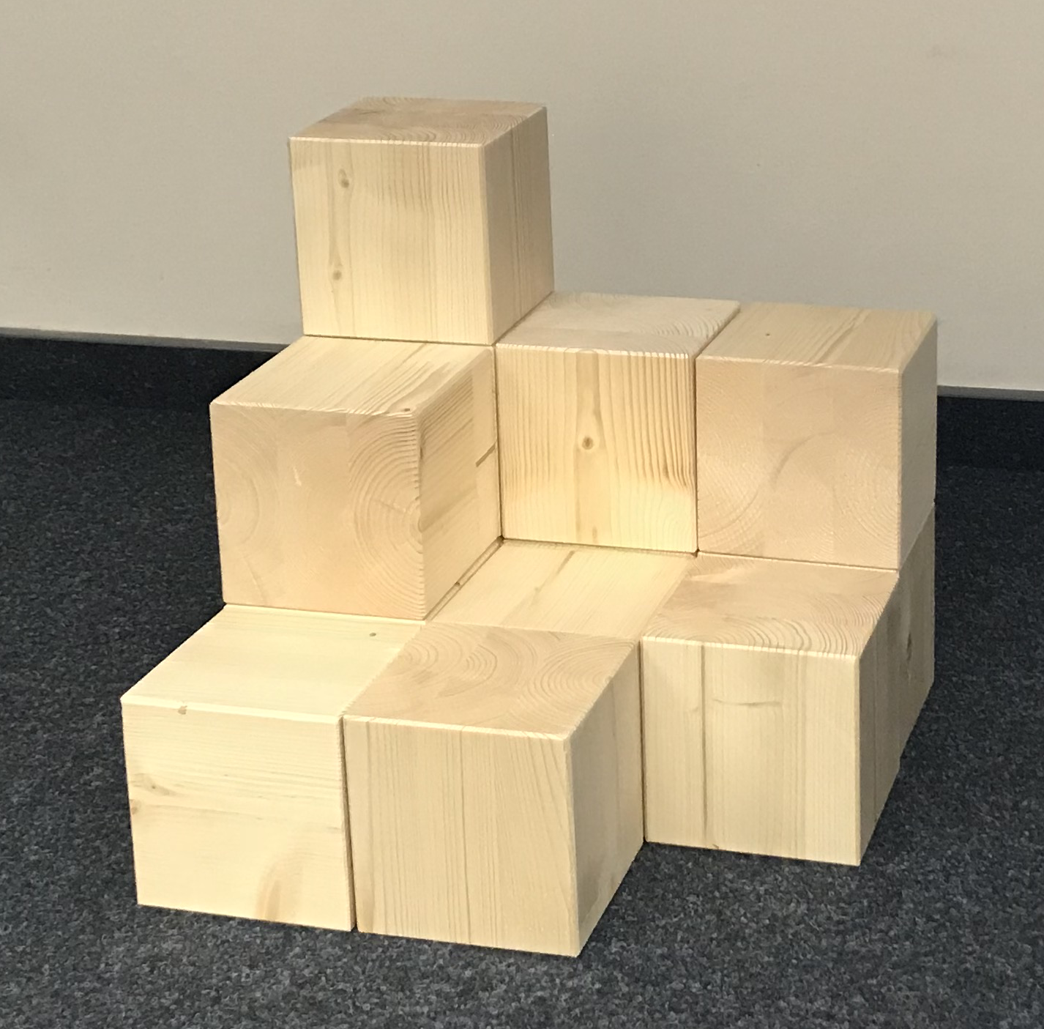
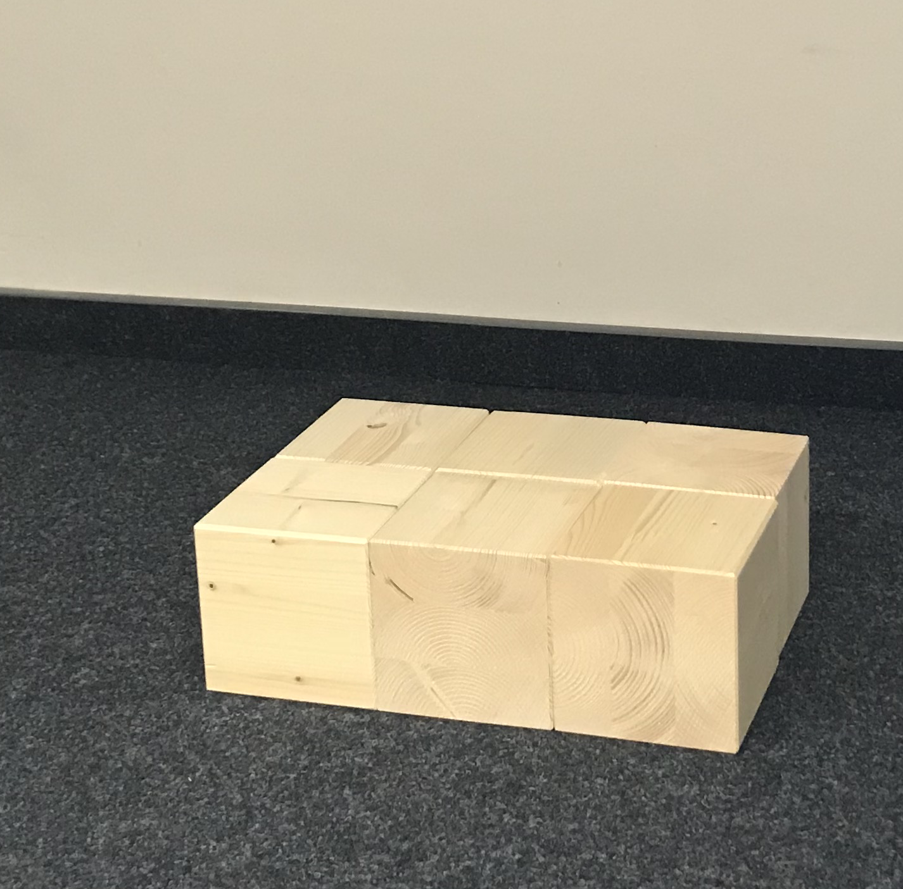
for task 6
Structure 1
Structure 2
Structure 3
Stefan Janke, Heiko Etzold

Slide 9
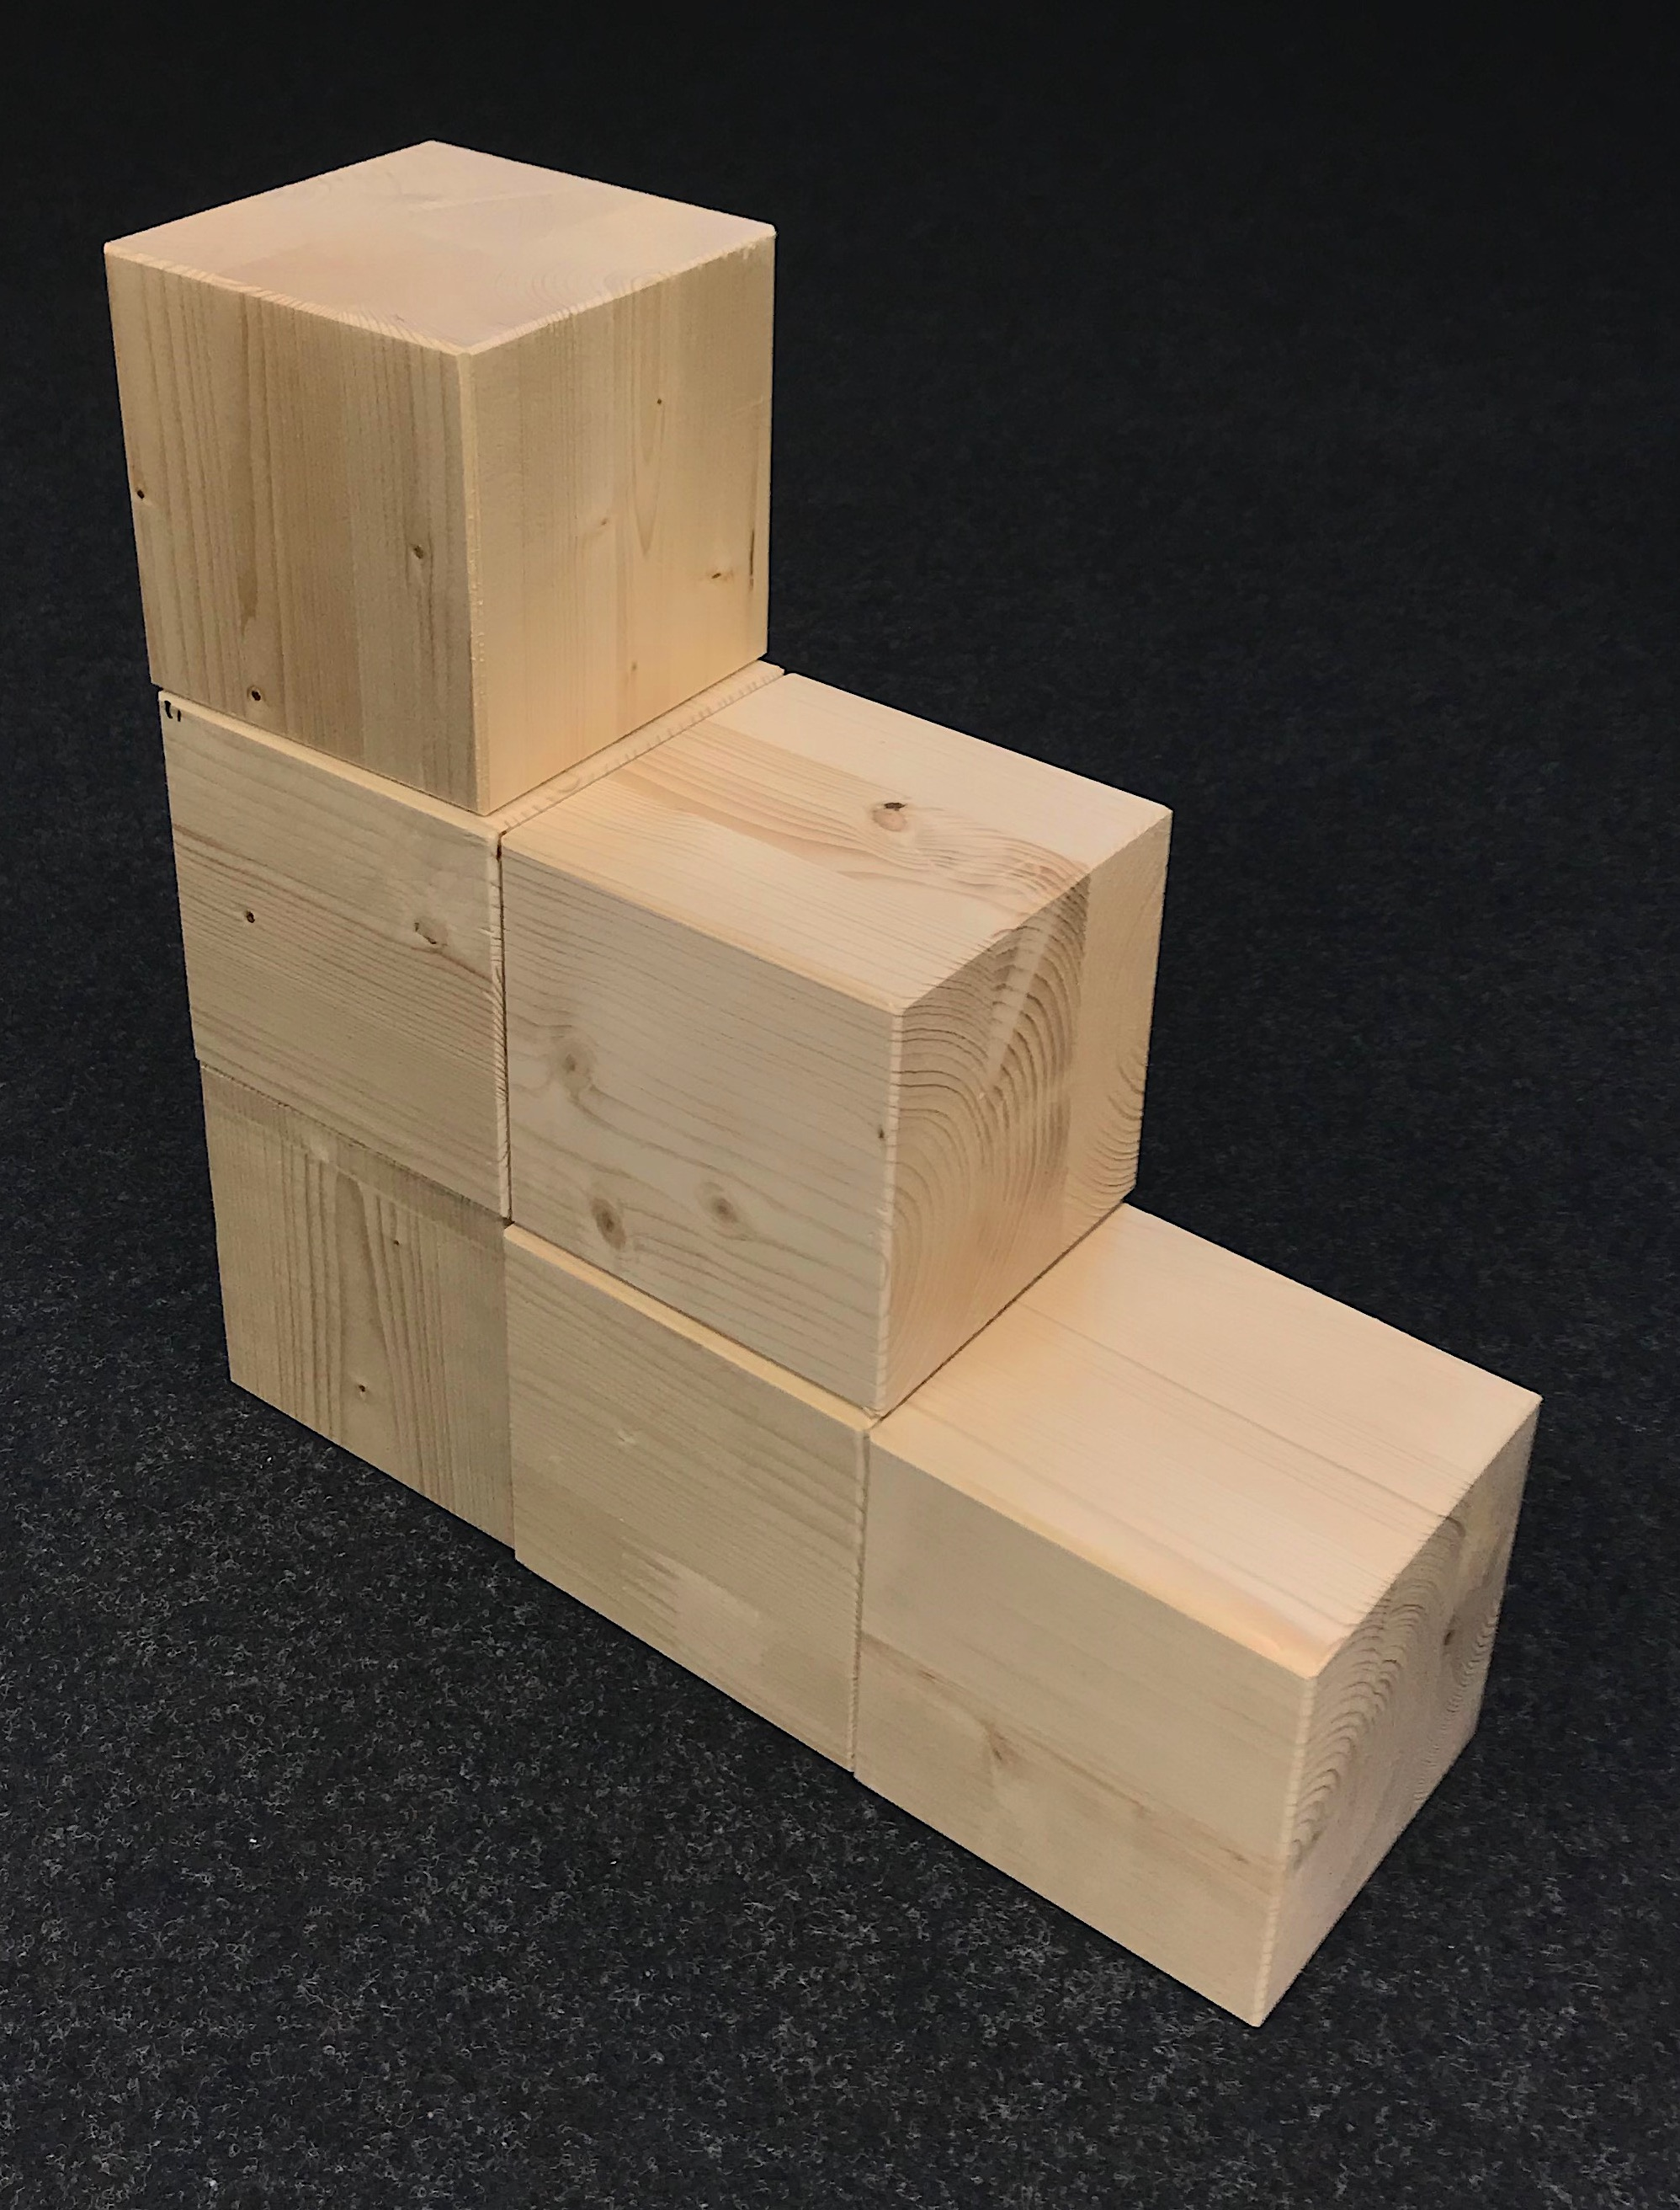
Construction processes
Build this cube structure in the code view!
Stefan Janke, Heiko Etzold

Slide 10
Construction processes
Compare the structure you have created with that of your neighbor.
The following questions can help you:
Has the same structure been created?
Does it look like the one on the table at the front?
Is the structure positioned correctly?
Can you find a difference in any of the different views?
Is one structure constructed "better" than the other? What might "better" mean in this context?
Stefan Janke, Heiko Etzold

Slide 11
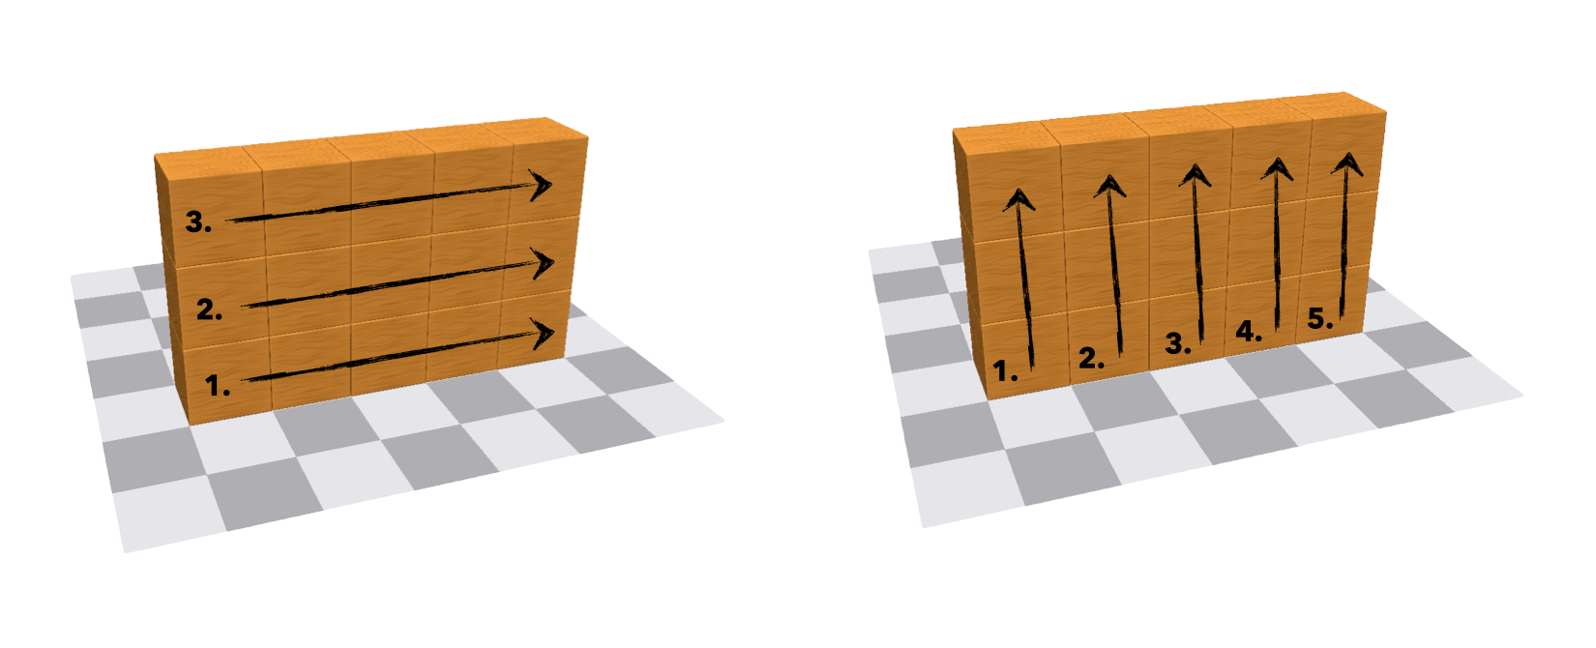
Construction processes
Stefan Janke, Heiko Etzold

Slide 12
Construction processes
Compared to all other views, the code view provides us not only with a unique representation of the cube structure but also with a description of the construction process.
Stefan Janke

Slide 13
Construction processes
How many different ways are there to build the cube structure without using a remove command?
Can I swap two commands at random, when looking only at the result?
Try to build the structure with exactly 20 commands! Is that even possible?
Which numbers of steps are possible?
Stefan Janke, Heiko Etzold

Slide 14
Wall construction
Build a wall that is 11 cubes long and 6 cubes high!
Stefan Janke

Slide 15
Tower construction
Build a bulky 2x2 tower with a height of 30!
Stefan Janke

Slide 16
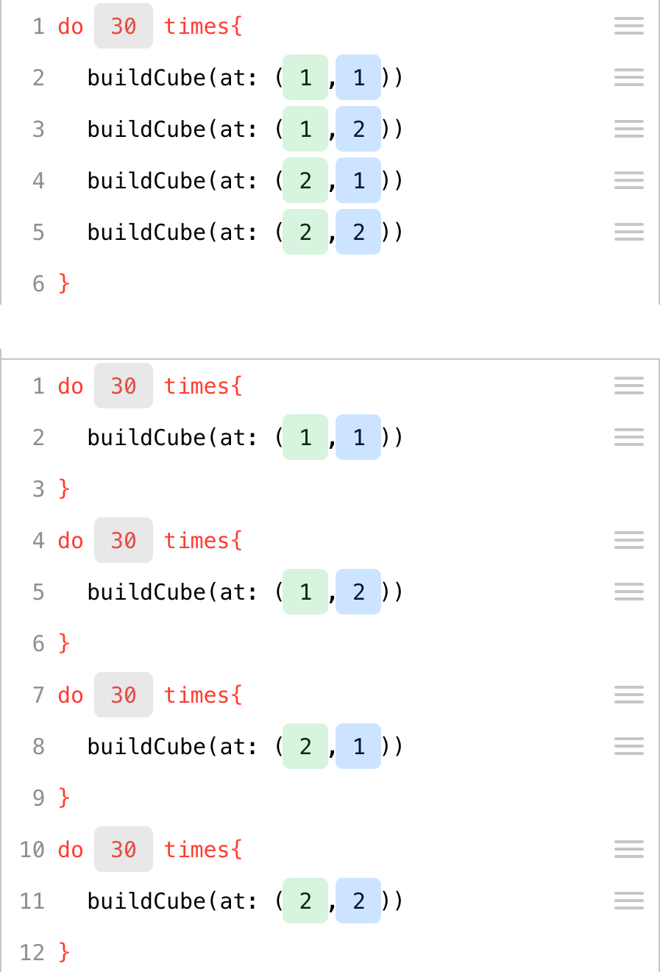
Tower construction
Stefan Janke, Heiko Etzold

Slide 17
Changing positions
Investigate for yourself what you can do with the commands “position” and “change”!
Stefan Janke

Slide 18
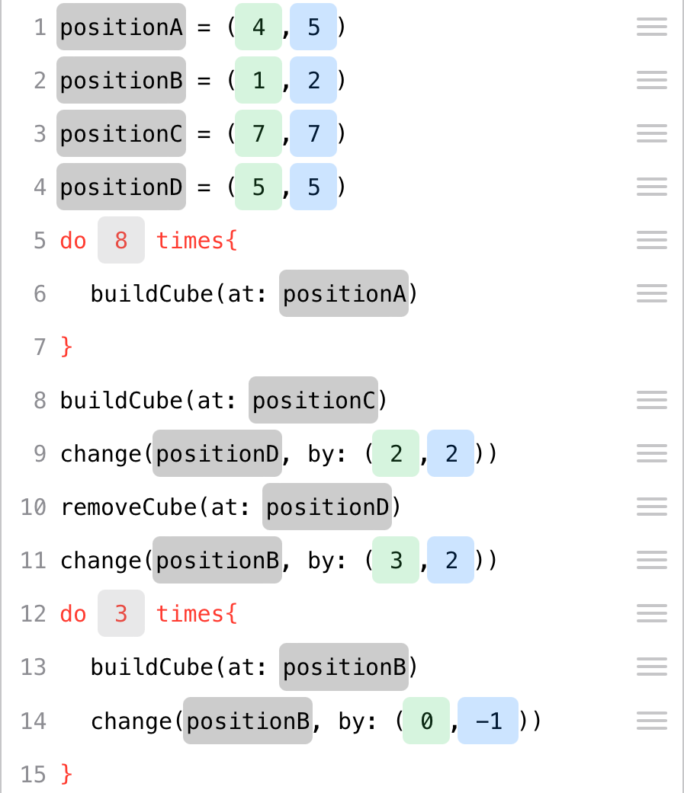
Changing positions
Stefan Janke, Heiko Etzold

Slide 19
Tasks
Build a cube on any random square!
From this square, continue building a row of 40 cubes in the following directions:
to the right - to the front
to the left - behind it
diagonally to the front right - diagonally to the front left
diagonally to the back left - diagonally to the back right
Stefan Janke

Slide 20
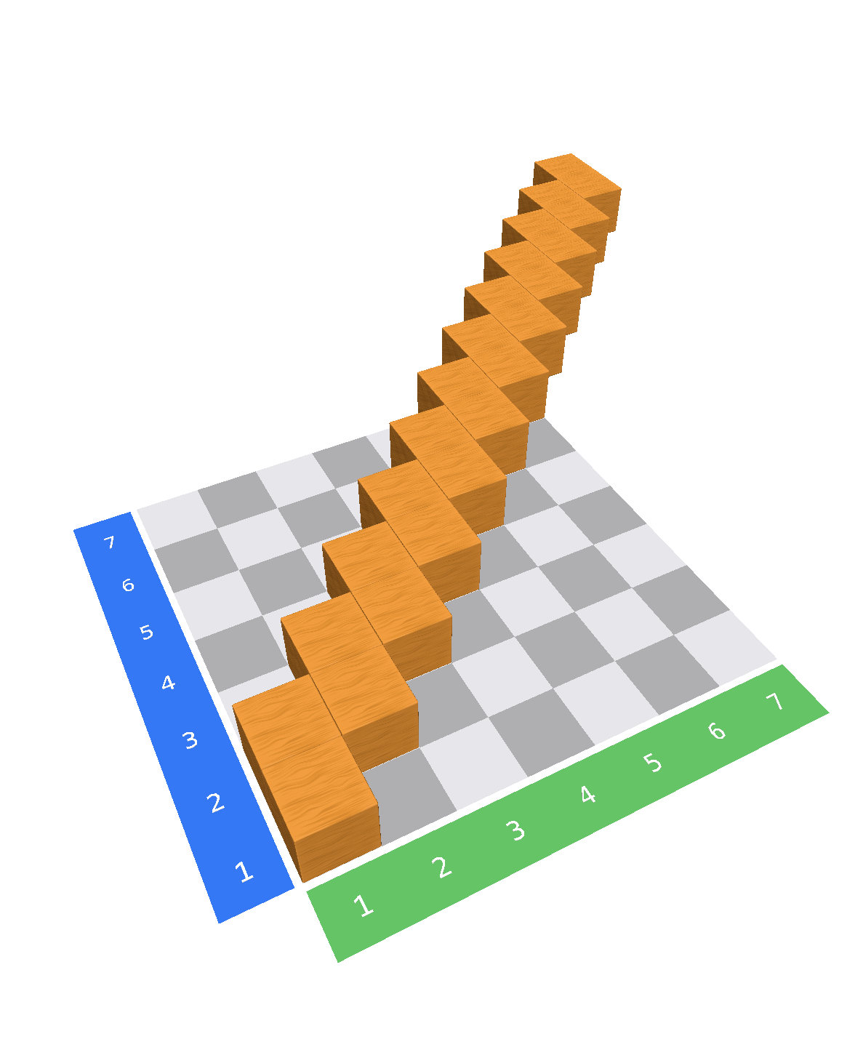
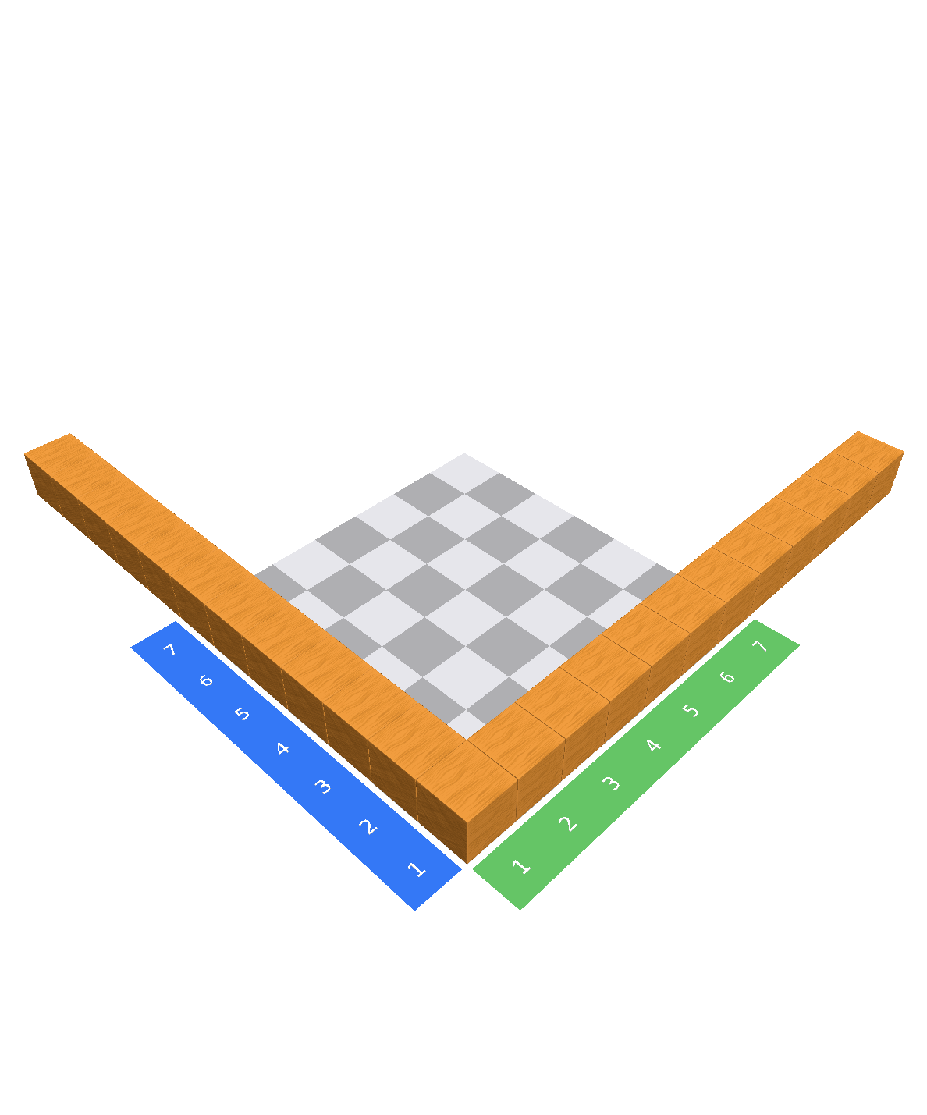
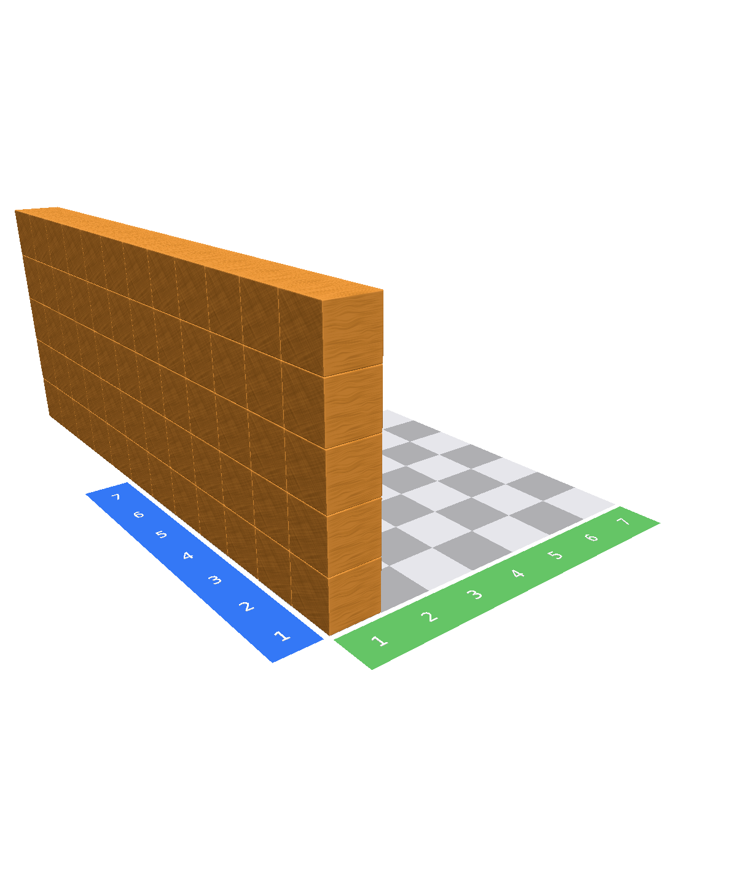
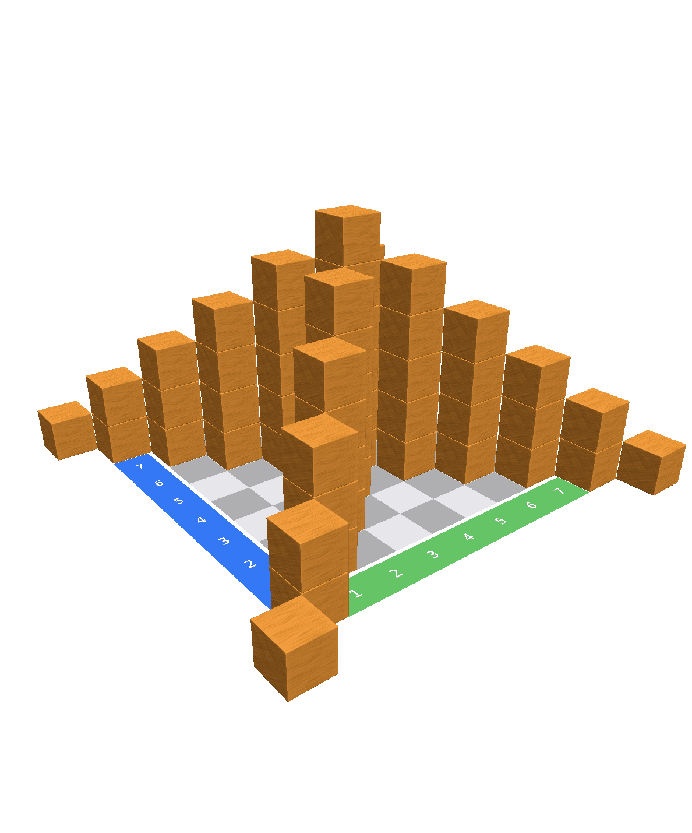
Complex exercises
Write a code to build the cube structures!
Structure 1
Structure 2
Structure 3
Structure 4
Stefan Janke, Heiko Etzold

Slide 21
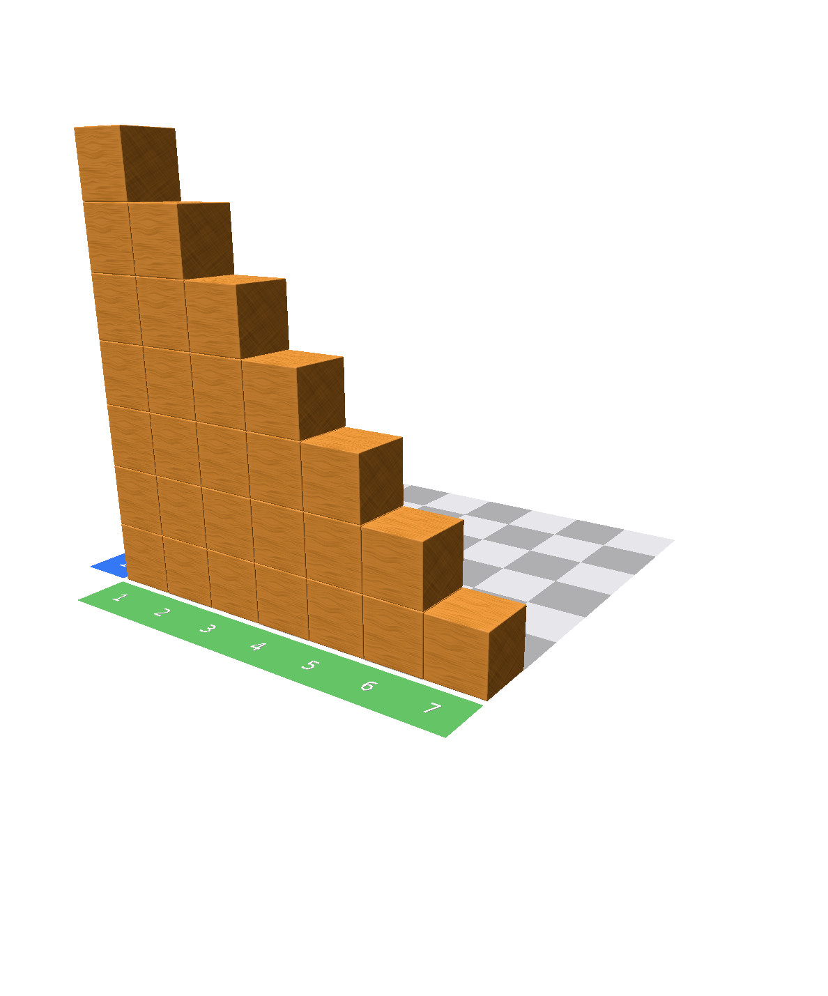
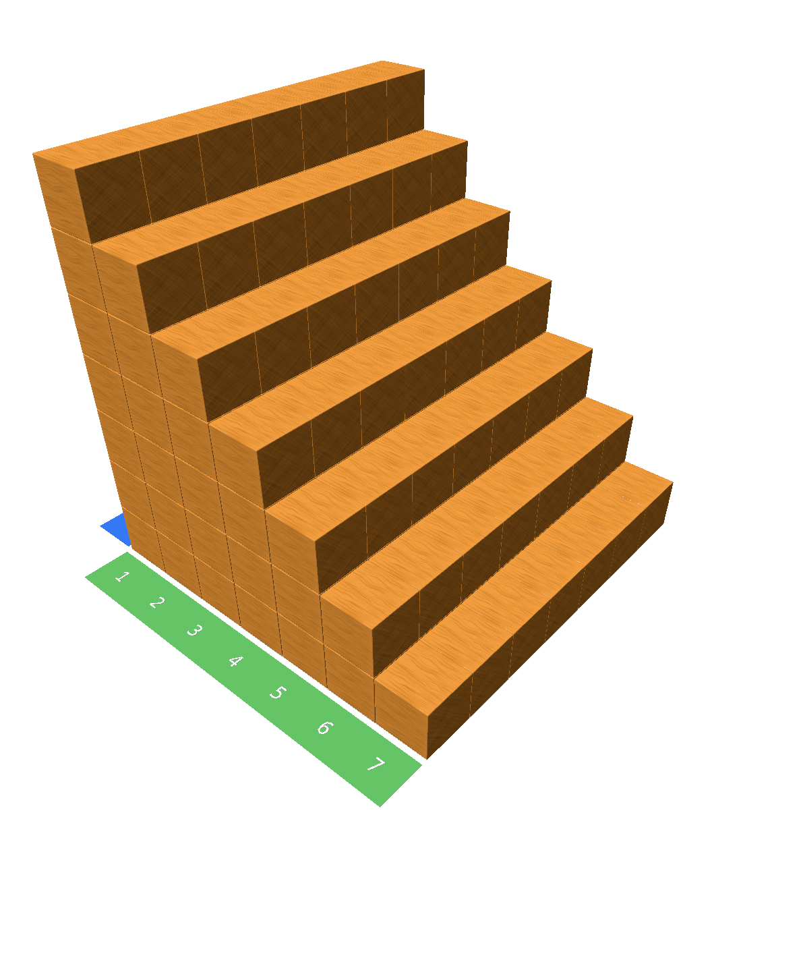
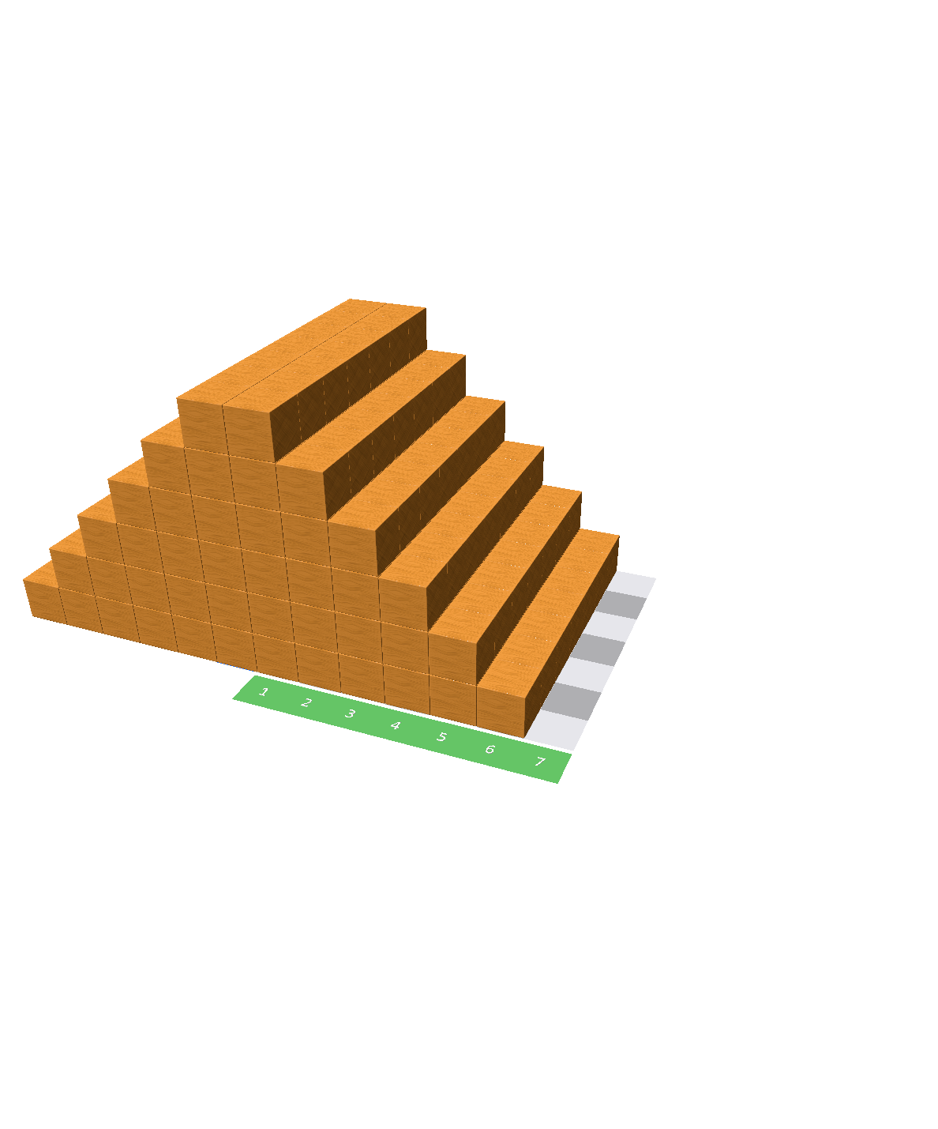
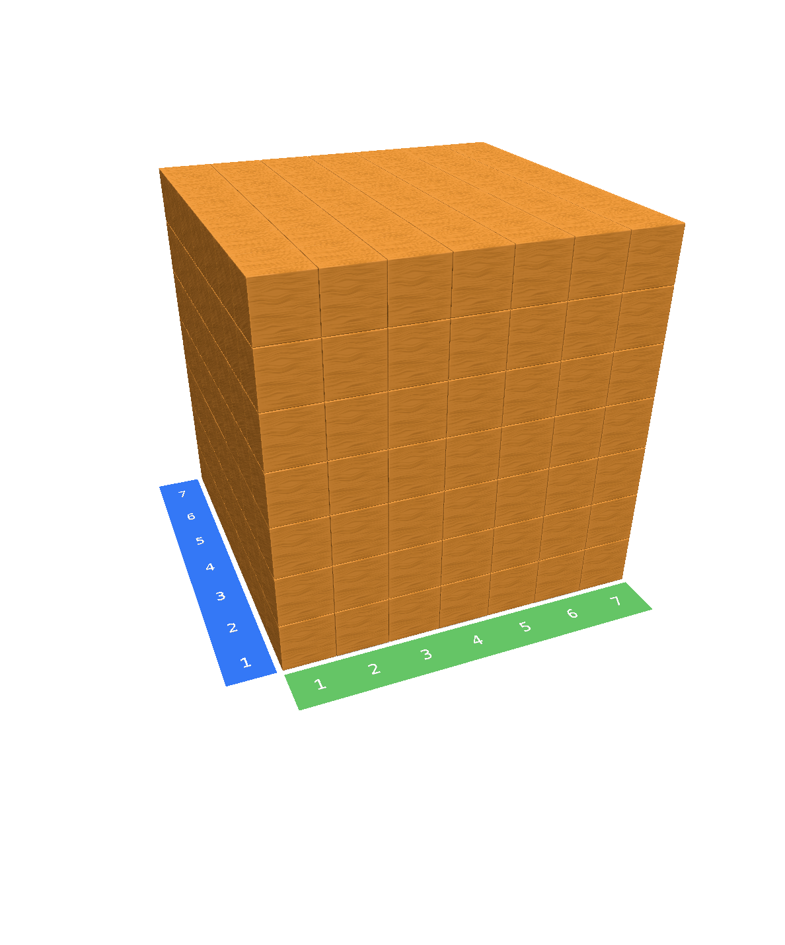
Complex exercises
Write a code to build the cube structures!
Structure 5
Structure 6
Structure 7
Structure 8
Stefan Janke, Heiko Etzold

